Slide 1
HTML - Audio, Video, SVG , Canvas

Slide 2
HTML Audio Tag
HTML audio tag is used to define sounds such as music and other audio clips. Currently there are three supported file format
mp3
wav
ogg
HTML Auio Example
<audio controls>
<source src="koyal.ogg" type="audio/ogg">
Your browser does not support the html audio tag.
</audio>

Slide 3
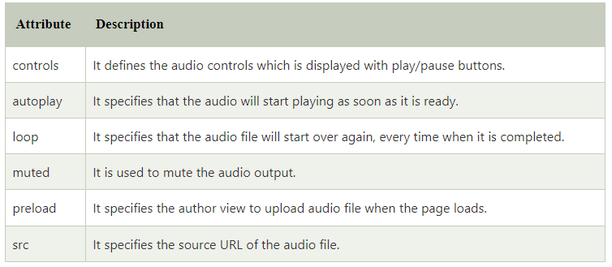
Attributes of HTML Audio Tag
There is given a list of HTML audio tag.

Slide 4
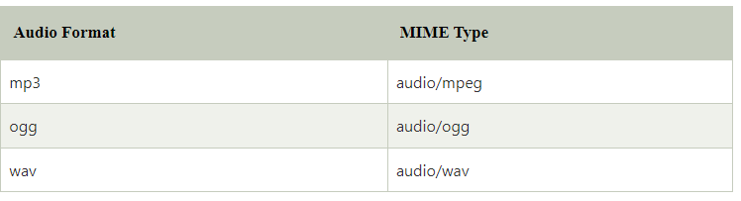
MIME Types for HTML Audio format
The available MIME type HTML audio tag is given below.

Slide 5
HTML Video Tag
HTML supports <video> tag also. The HTML video tag is used for streaming video files such as a movie clip, song clip on the web page.
Currently, there are three video formats supported for HTML video tag:
mp4
webM
ogg

Slide 6
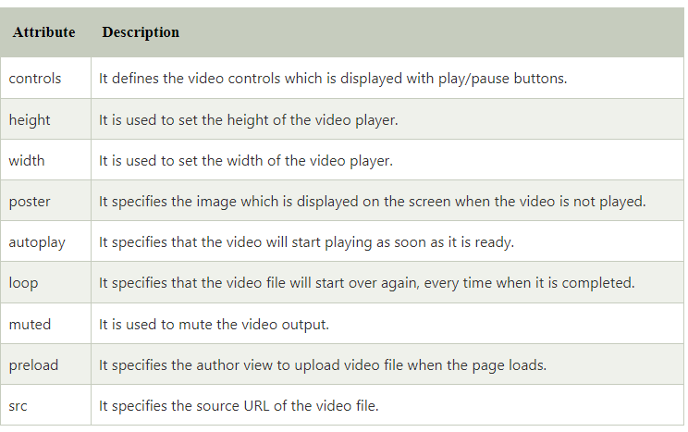
Attributes of HTML Video Tag

Slide 7
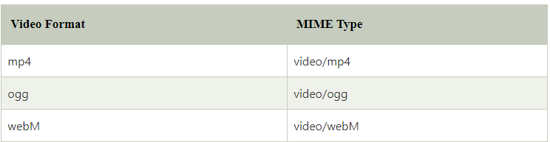
MIME Types for HTML Video format
The available MIME type HTML video tag is given below.

Slide 8
MIME Types for HTML Video format
The available MIME type HTML video tag is given below.

Slide 9
Video Tag example
<video controls>
<source src="movie.mp4" type="video/mp4">
Your browser does not support the html video tag.
</video>

Slide 10
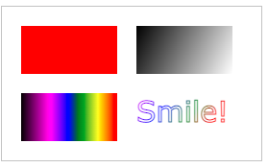
HTML Canvas Graphics
The HTML <canvas> element is used to draw graphics on a web page.
The graphic to the left is created with <canvas>. It shows four elements: a red rectangle, a gradient rectangle, a multicolor rectangle, and a multicolor text.

Slide 11
HTML Canvas Graphics
The HTML <canvas> element is used to draw graphics on a web page.
The graphic to the left is created with <canvas>. It shows four elements: a red rectangle, a gradient rectangle, a multicolor rectangle, and a multicolor text.

Slide 12
What is HTML Canvas?
The HTML <canvas> element is used to draw graphics, on the fly, via JavaScript.
The <canvas> element is only a container for graphics. You must use JavaScript to actually draw the graphics.
Canvas has several methods for drawing paths, boxes, circles, text, and adding images.

Slide 13
Canvas Examples
A canvas is a rectangular area on an HTML page. By default, a canvas has no border and no content.
The markup looks like this:
<canvas id="myCanvas" width="200"height="100"></canvas>

Slide 14
Add a JavaScript
After creating the rectangular canvas area, you must add a JavaScript to do the drawing.
Here are some examples:
Draw a Line
<script>
var c = document.getElementById("myCanvas");
var ctx = c.getContext("2d");
ctx.moveTo(0, 0);
ctx.lineTo(200, 100);
ctx.stroke();
</script>

Slide 15
Draw a Circle
<script>
var c = document.getElementById("myCanvas");
var ctx = c.getContext("2d");
ctx.beginPath();
ctx.arc(95, 50, 40, 0, 2 * Math.PI);
ctx.stroke();
</script>
Draw a Text
<script>
var c = document.getElementById("myCanvas");
var ctx = c.getContext("2d");
ctx.font = "30px Arial";
ctx.fillText("Hello World", 10, 50);
</script>

Slide 16
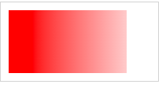
Draw Linear Gradient
<script>
var c = document.getElementById("myCanvas");
var ctx = c.getContext("2d");
// Create gradient
var grd = ctx.createLinearGradient(0, 0, 200, 0);
grd.addColorStop(0, "red");
grd.addColorStop(1, "white");
// Fill with gradient
ctx.fillStyle = grd;
ctx.fillRect(10, 10, 150, 80);
</script>

Slide 17
HTML SVG Graphics
SVG stands for Scalable Vector Graphics
SVG is used to define graphics for the Web
The HTML <svg> Element
The HTML <svg> element is a container for SVG graphics.
SVG has several methods for drawing paths, boxes, circles, text, and graphic images.

Slide 18
SVG Circle
<svg width="100" height="100">
<circle cx="50" cy="50" r="40" stroke="green" stroke-width="4" fill="yellow" />
</svg>
SVG Rectangle
<svg width="400" height="100">
<rect width="400" height="100" style="fill:rgb(0,0,255);stroke-width:10;stroke:rgb(0,0,0)" />
</svg>

Slide 19
SVG Rounded Rectangle
<svg width="400" height="180">
<rect x="50" y="20" rx="20" ry="20" width="150" height="150"
style="fill:red;stroke:black;stroke-width:5;opacity:0.5" />
</svg>
SVG Star
<svg width="300" height="200">
<polygon points="100,10 40,198 190,78 10,78 160,198"
style="fill:lime;stroke:purple;stroke-width:5;fill-rule:evenodd;" />
</svg>

Slide 20
SVG Logo
<svg height="130" width="500">
<defs>
<linearGradient id="grad1" x1="0%" y1="0%" x2="100%" y2="0%">
<stop offset="0%" style="stop-color:rgb(255,255,0);stop-opacity:1" />
<stop offset="100%" style="stop-color:rgb(255,0,0);stop-opacity:1" />
</linearGradient>
</defs>
<ellipse cx="100" cy="70" rx="85" ry="55" fill="url(#grad1)" />
<text fill="#ffffff" font-size="45" font-family="Verdana" x="50" y="86">SVG</text>
Sorry, your browser does not support inline SVG.
</svg>

Slide 21
HTML Email Tag
HTML <a> tag provides you option to specify an email address to send an email. While using <a> tag as an email tag, you will use mailto: email address along with href attribute. Following is the syntax of using mailto instead of using http.
<a href = "mailto:abc@example.com?subject = Feedback&body = Message">
Send Feedback
</a>

